Slide 1
Sport qualities

Slide 2
Learning Objectives
8.2.2.1 understand with little or no support most specific information in extended talk on a wide range of general and curricular topics
8.2.4.1 understand with little or no support most of the implied meaning in extended talk on a range of general and curricular topics
8.3.3.1 Give an opinion at discourse level on a wide range of general and curricular topics.

Slide 3
Running dictation

Slide 4
People all over the world are very fond of sports and games. That is one of the things in which people of every nationality and class are united.
The most popular outdoor winter sports are shooting, hunting, hockey and, in the countries where the weather is frosty and there is much snow — skating, skiing.
It's so nice to go to the skating-rink on a frosty sunny day. Some people prefer to be out of town in such weather and to sledge or to ski in the woods. Many people greatly enjoy figure-skating and ski-jumping.
Summer affords excellent opportunities for swimming, boating, yachting, cycling, gliding and many other sports. Among outdoor games football takes the first place in public interests; this game is played in all the countries of the world.
The other games are cricket, volleyball, basketball, and so on. Badminton is also very popular both with young and old.
All the year round many people indulge in boxing, wrestling, gymnastics and track and field events. Over the last few years aerobics has become popular with young girls and women.
Among indoor games which one can go in for all the year round are billiards, table tennis, chess, of course. The results of chess tournaments are studied and discussed by enthusiasts in different countries.
So we have all grounds to say that sport is one of the things that makes people kin.

Slide 5
Sport qualities
Beautiful Determined
Strong Motivated
Nice Passive
Good-looking Hard-working
Active Lazy
Healthy Passionate
Strict Competitive
Kind Handsome
Confident Athletic
Sensitive

Slide 6

Let’s have a rest

Slide 7

While-listening activity:
Listen to the text and fill in the gaps.
Descriptor | A learner
8.2.2.1 understand with little or no support most specific information in extended talk on a wide range of general and curricular topics | You will achieve this LO if you can complete at least 4 sentences. You may have one spelling mistakes in each answer.

Slide 8
Are you good at sport? I’m not, but I love watching and playing all kinds of sport. My favorite sport is football – the kind with the round ball, not American football. I wasn’t very good at football when I was a kid. This did not stop me playing. I played in the park with my friends for hours every day. What is your national sport? Do you like it? I love Japan’s national sport sumo. It is one of the most exciting sports in the world. You have to spend a little time getting to know the rules and the fighters. The greatest thing about sport is that it brings people together from all over the world. Another good thing is that it keeps us healthy. Sports stars are very lucky. They love their job and stay fit by doing it every day. What are you going to play next?

Slide 9
Post-listening activity:
Make up four questions to the text and ask your opponents.
Descriptor | A learner
8.3.3.1 Give an opinion at discourse level on a wide range of general and curricular topics. | You will achieve this LO if you can make up and answer 4 questions. Uses appropriate vocabulary to talk about a limited range of general and curricular topics. Occasional mistakes do not cause comprehension problems.

Slide 10
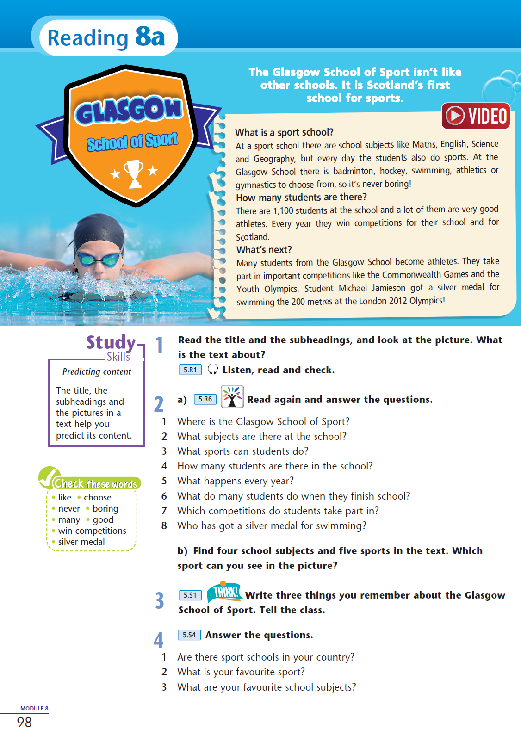
Home task:
Ex 1-2 p. 43
For students who want to know more about sport

Slide 11

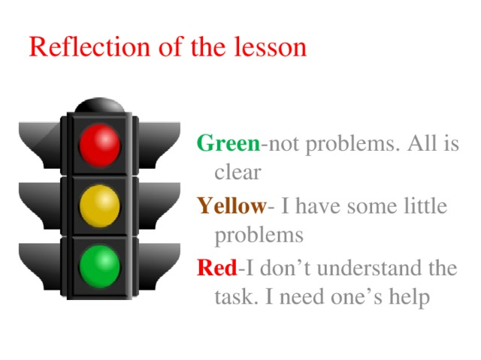
Reflection

